Slide 1
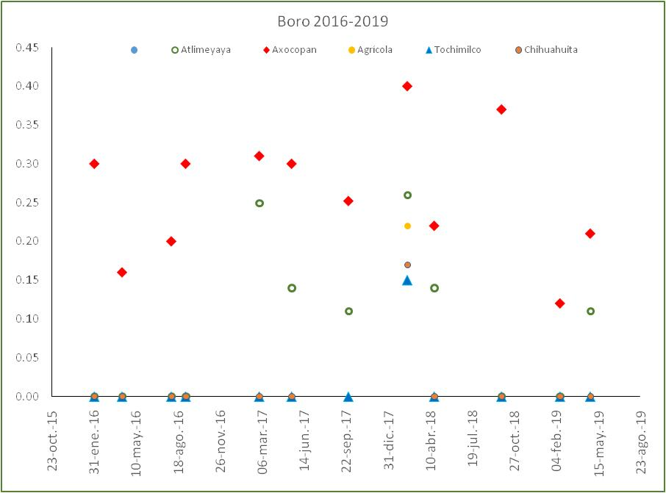

Slide 2
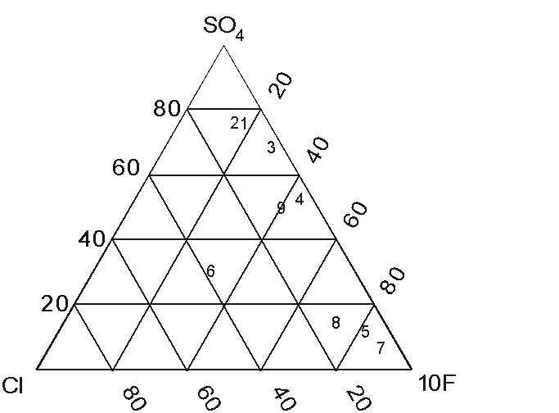
14/06/2019
3/06/19
09-20-99
x
X
10-03-2000
11-01-2000
12-14-2000
1-08-2016
X
Y
X
12-20-2000
M
W
2 mayo 2012
7 mayo 2013

Slide 3
Relative Cl, F and SO4 concentrations of ash leachates. (a) Data for 1994±1995. Numbers correspond to the following dates: (1) 21/12/94, (2) 23/12/94, (3) 4/01/95, (4) 7/01/95, (5) 13/01/95, (6) 14/01/95, (7) 20/01/95, (8) 2/03/95 and (9) 4/04/95. (b) Data for 1996. Numbers correspond to the following dates: (1) 5/03/96, (2) 6/03/96, (3) 8/03/96, (4) 9/03/96, (5) 11/03/96, (6) 12/03/96, (7) 14/03/96, (8) 23/03/96, (9) 6/04/96, (10) 11/04/96, (11) 20/04/96, (12) 30/04/96, (13) 4/05/96, (14) 5/06/96, (15) 19/06/96, (16) 4/08/96 and (17) 28/11/96. B and M represent the composition of vapors formed from a basaltic and an andesitic magma, respectively (after Giggenbach, 1996).

