Slide 1
COMITÉ HIDROCARBUROS-SINAPROC
Marzo, 2019

Slide 2
Contents
The role of trucking in the mexican energy markets:
Impact of fuel trucking in Mexico
Principal routes
Regulatory considerations

Slide 3
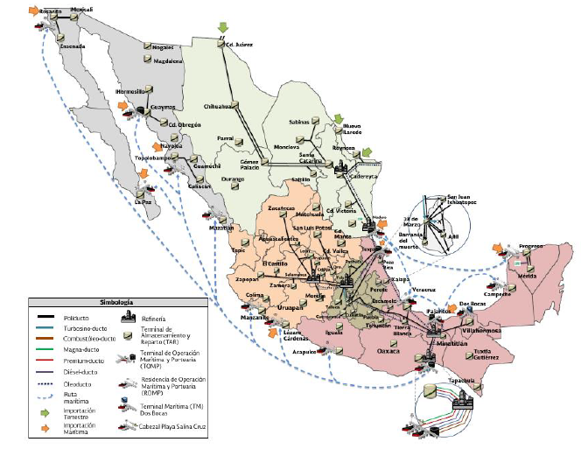
Impact of fuel trucking in Mexico
Distribution of more than 350 thousand barrels of refined products per day, which represents 30% of the national consumption.
Where are we loading?
Ports
Storage Terminals
Refineries
Vessels and train by transloading
A company by Grupo

Slide 4
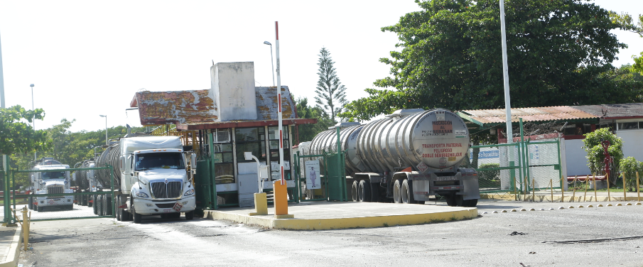
Storage Terminals
A company by Grupo

Slide 5
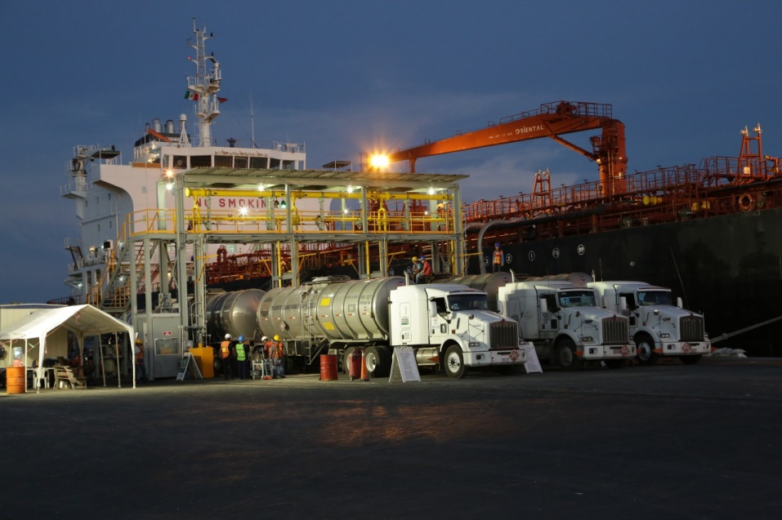
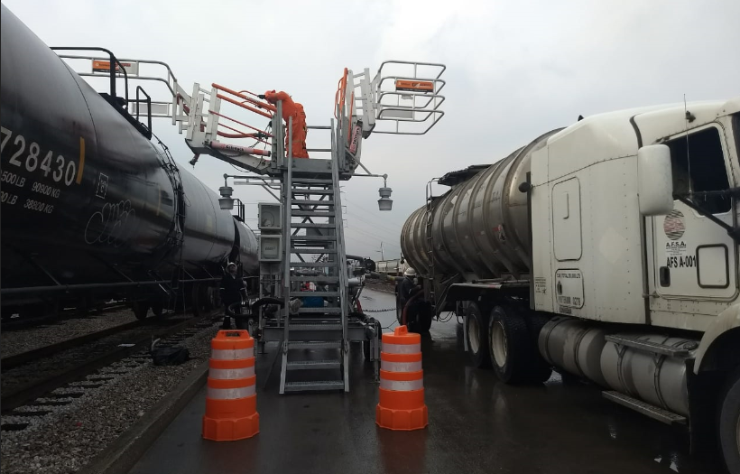
Transloading from train and vessels
Since 2017, Grupo Transportes started a new chapter in our history, giving service to private companies, with flexibility and reliability in the supply of fuels.
Transloading train – tank truck
Transloading vessels – tank truck
A company by Grupo

Slide 6
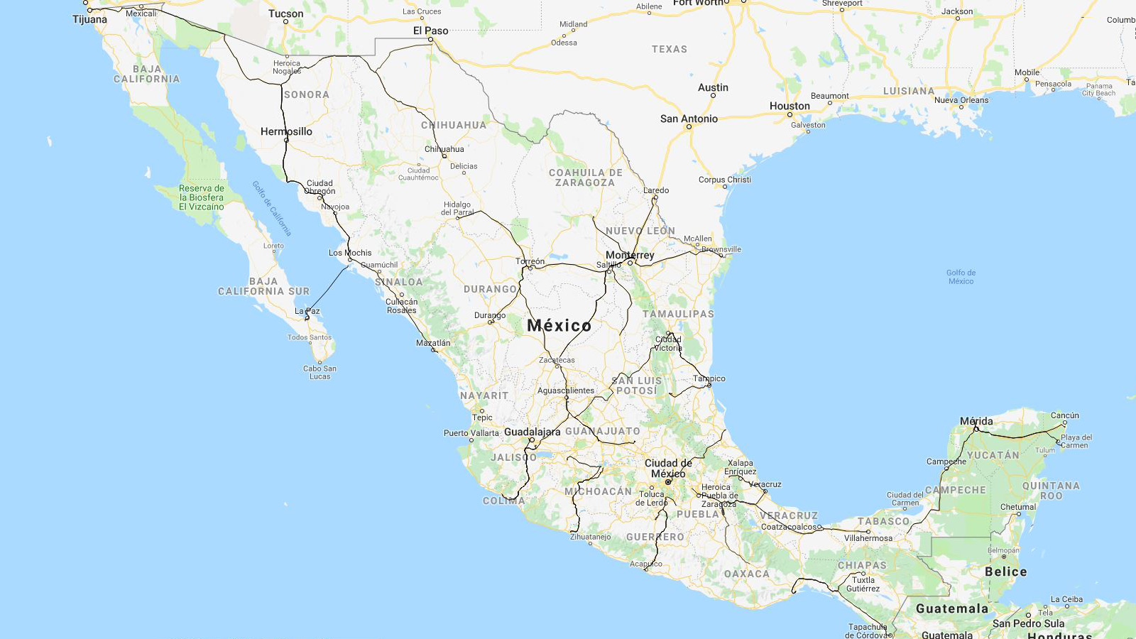
The Principal Long Routes in Mexico
Why is trucking important to Mexico?

Slide 7
Modalities of transportation
Long Route Transportation
Last Mile Transportation
Full modality, with a capacity of 62,000 liters.
Recommended for more than 100 km routes.
Simple modality, with a capacity of 31,000 and 20,000 liters.
Less than 100 km routes.
A company by Grupo

Slide 8
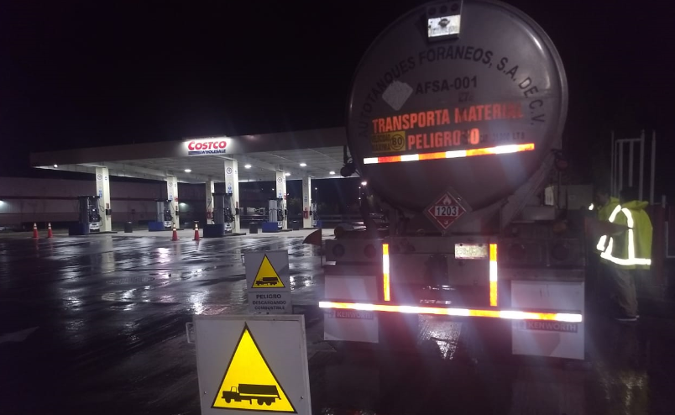
Gas Stations Supply – Last Mile Delivery
A company by Grupo

Slide 9
Last update of the Regulation: 26/12/2017

Slide 10
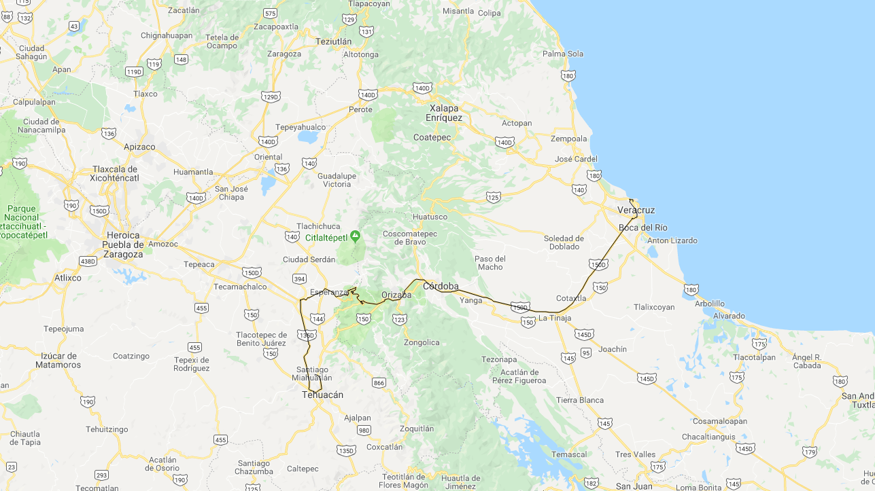
NOM-087-SCT-2-2017, Example: Minimum hours of driving.
Last update of the Regulation: 28/06/2018
VERACRUZ-TEHUACAN
Veracruz / Esperanza | 4 hrs.
Esperanza / Tehuacán | 01:30 hrs.
Driving Time | 5:30 hrs.
This law refers to safety operations, specifically the maximum hours of operations per operator, with two assumptions:
Schedules shorter than 7 hours.
Maximum Schedules of
14 hours.
First assumption: Travel hours Veracruz - Tehuacan
When the schedule is shorter than 7 hours.

Slide 11
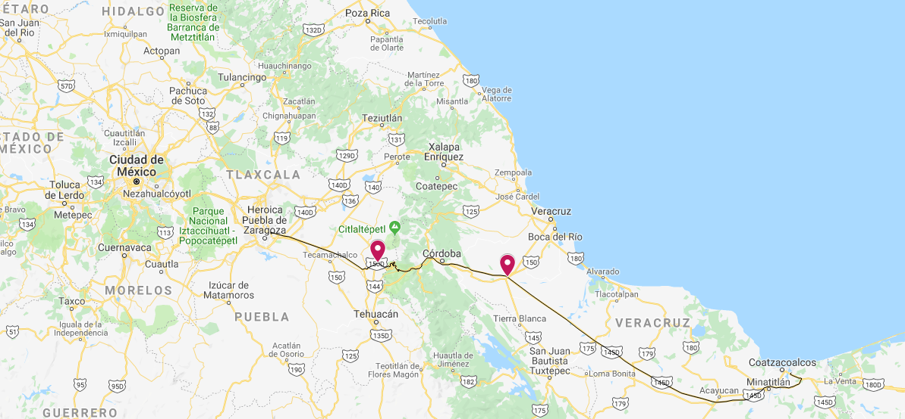
NOM-087-SCT-2-2017, Example: Maximum hours of driving.
Last update of the Regulation: 28/06/2018
Pajaritos-Puebla
Pajaritos / Cosamaloapan | 3:30 hrs
Cosamaloapan / La Tinaja | 1:30 hrs
Driving Break (2) | 3:00 hrs
La Tinaja / Esperanza | 3:40 hrs
Esperanza / Puebla | 1:30 hrs
Driving Time | 13:10 hrs
Second assumption: Travel hours Pajaritos - Puebla
When the schedule is longer than 7 hours, they need to make a 30 minutes rest every 5 hours.
After 14 hours, operators need to pause for 8 hours.

Slide 12
We are…
Thank you!

